Slide 1
Learning Objective
I will be able to sketch circles from an equation
Success Criteria
At the end of the lesson, I will be able to:
Sketch circles;
Determine key features of a circle.

Slide 2
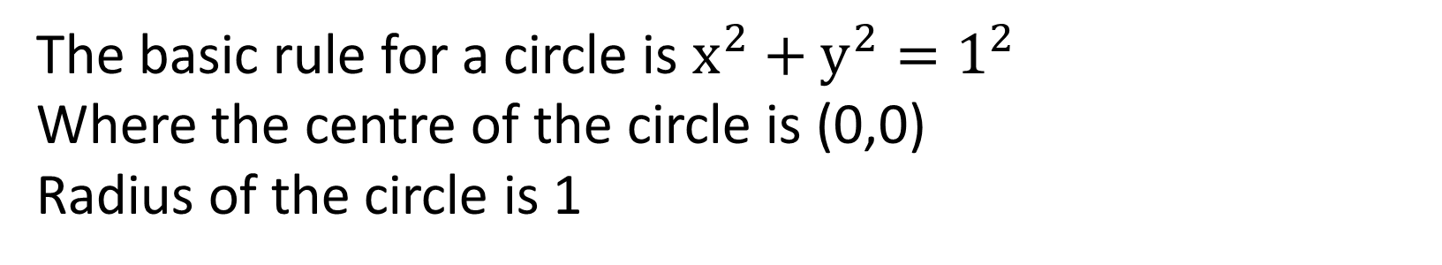
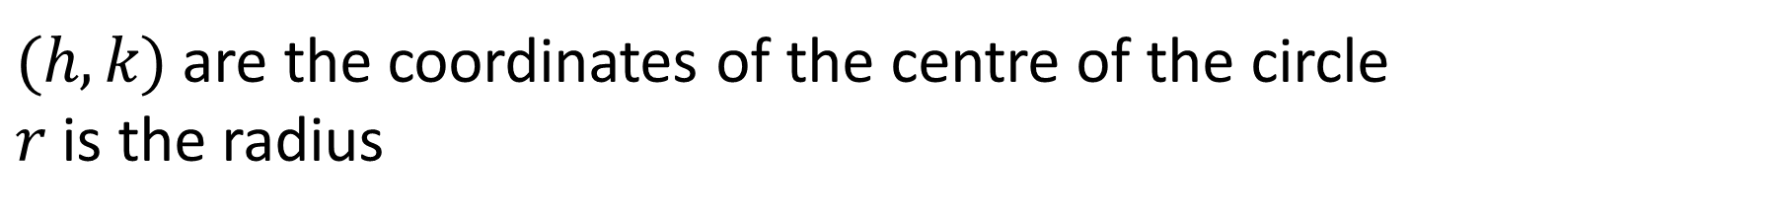
Concept Development
Standard form of a circle: ${\left(x−h\right)}^{2}+{(y−k)}^{2}=r^{2}$
$(h,k)$ are the coordinates of the centre of the circle
$r$ is the radius
The basic rule for a circle is $x^{2}+y^{2}=1^{2}$
Where the centre of the circle is (0,0)
Radius of the circle is 1

Slide 3


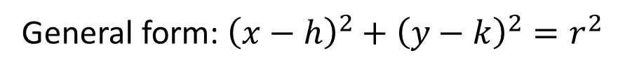
Cambridge Ch 4D Ex 7
Write down the equation of the circle with centre $(−3,5)$ and radius 2.
General form: ${\left(x−h\right)}^{2}+{\left(y−k\right)}^{2}=r^{2}$
$$h=−3, k=5, r=2$$
$${\left(x−\left(−3\right)\right)}^{2}+{\left(y−5\right)}^{2}=2^{2}$$
$${\left(x+3\right)}^{2}+{\left(y−5\right)}^{2}=4$$
Cambridge Ch 4D Ex 8
Find the centre and radius of the circle with equation ${\left(x−1\right)}^{2}+{\left(y−2\right)}^{2}=4$
$$h=1, k=,2 r=2$$
Centre $(1,2)$

Slide 4
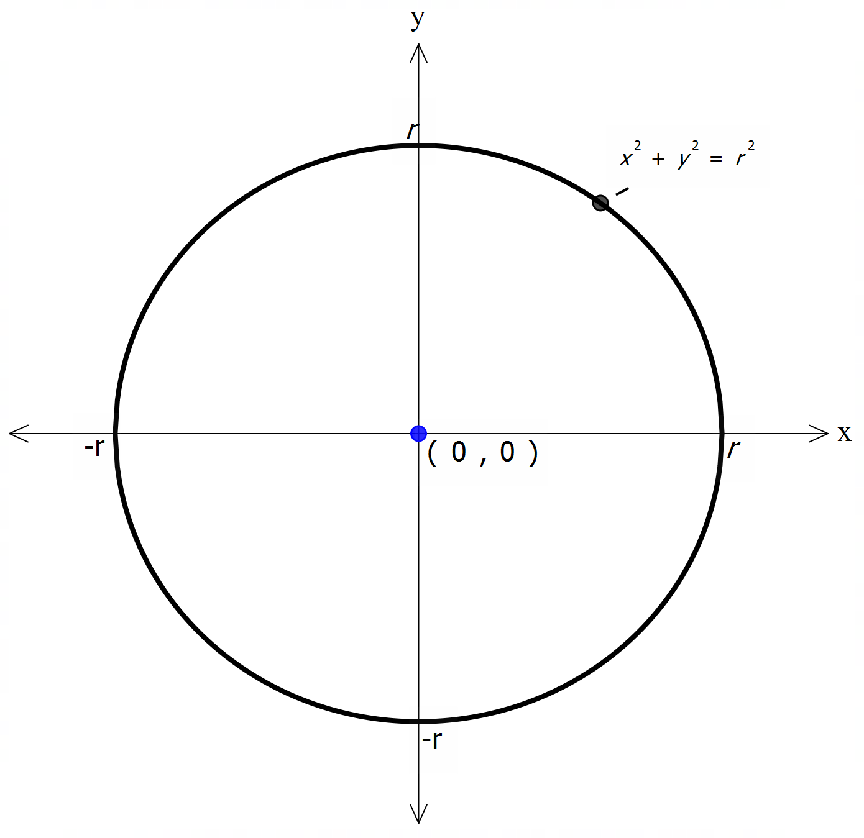

Concept Development
Key features of a circle graph:
Centre
Radius
Any $x−$ and $y−$ intercepts

Slide 5

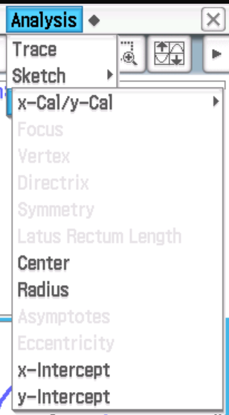
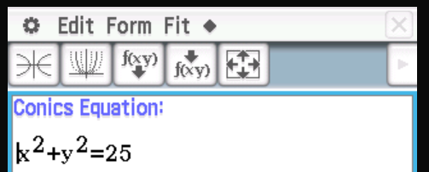
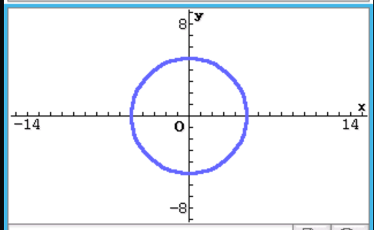


Plotting in ClassPad
Consider the graph $x^{2}+y^{2}=25$
Go to
What’s the coordinates of the centre of the circle?
What’s the radius?
Enter in Equation:$x^{2}+y^{2}=25$
$$(0,0)$$
S$elect graph icon$
$$r=5$$

Slide 6
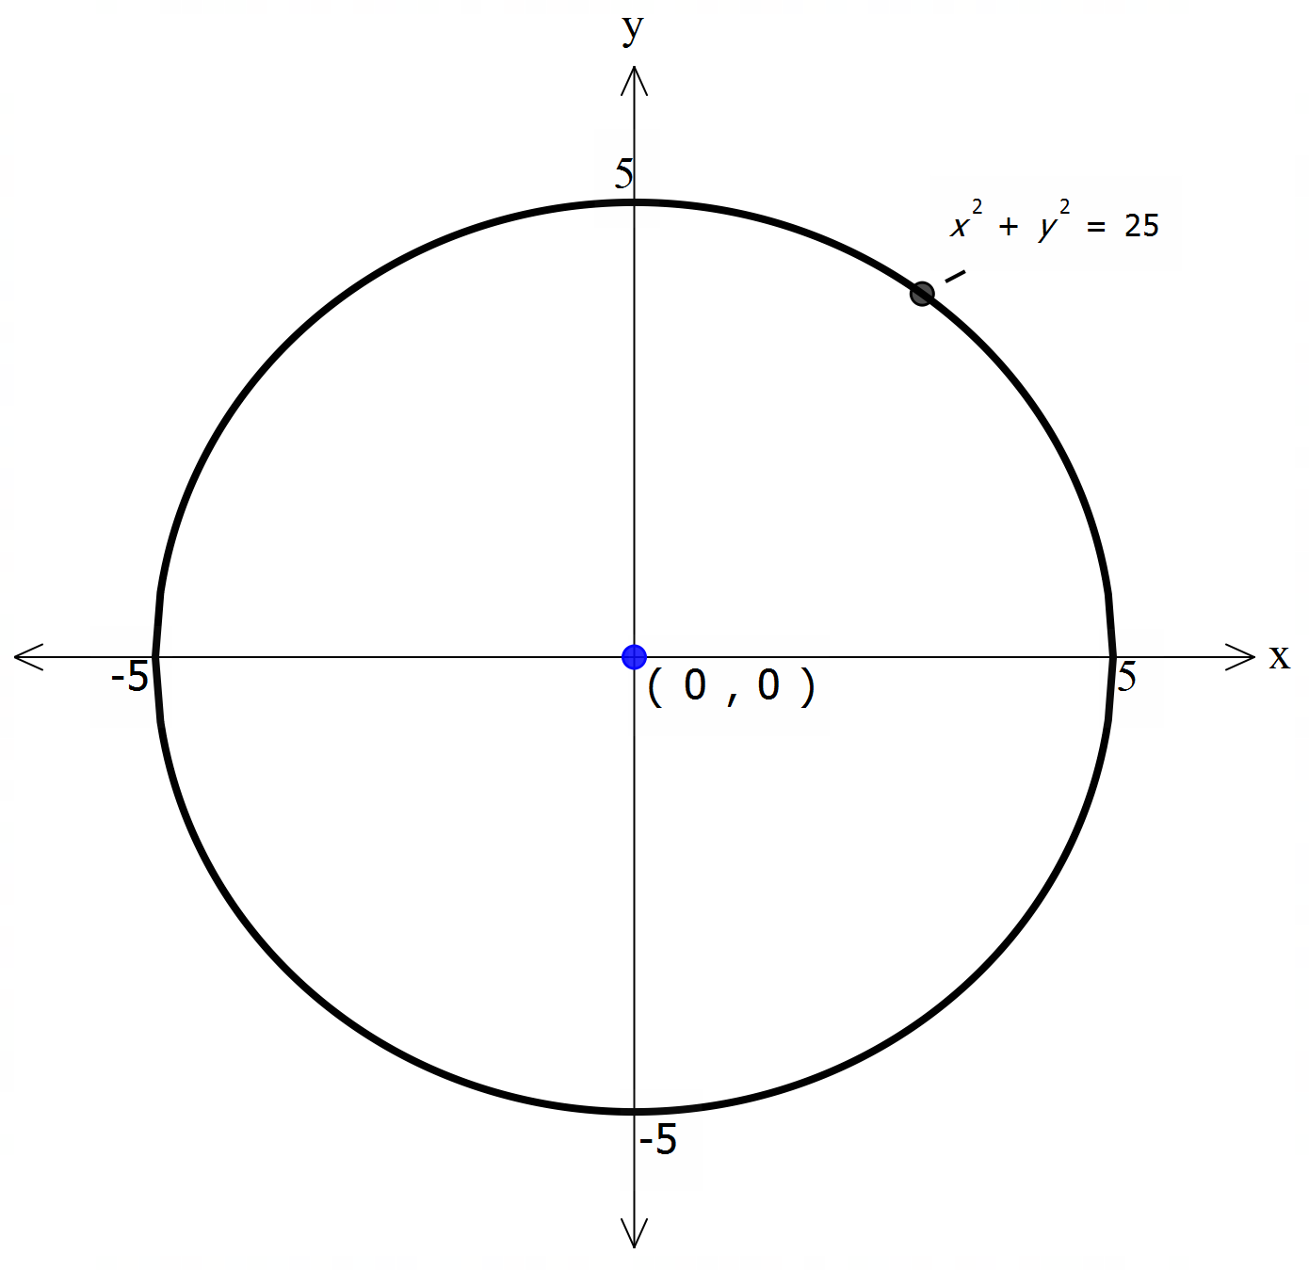

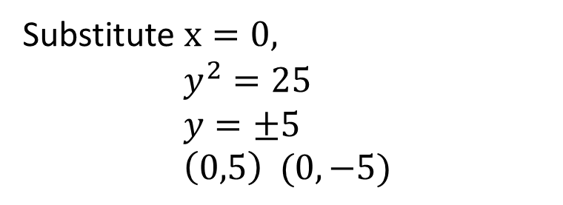
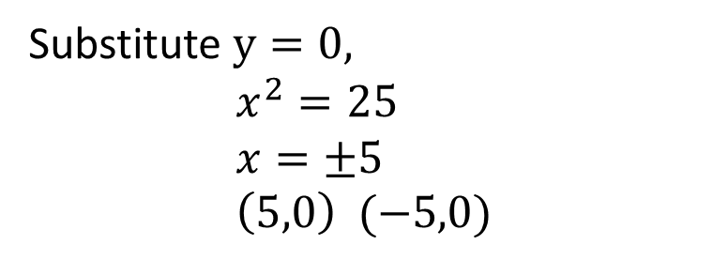

Concept Development
Sketch the graph $x^{2}+y^{2}=25$
$$(0,0)$$
Centre of the circle:
Radius:
$$r=5$$
x- intercepts
Substitute $y=0,$ $$x^{2}=25 \\ x=±5 \\ \left(5,0\right) (−5,0)$$
y- intercepts:
Substitute $x=0,$ $$y^{2}=25 \\ y=±5 \\ \left(0,5\right) (0,−5)$$

Slide 7
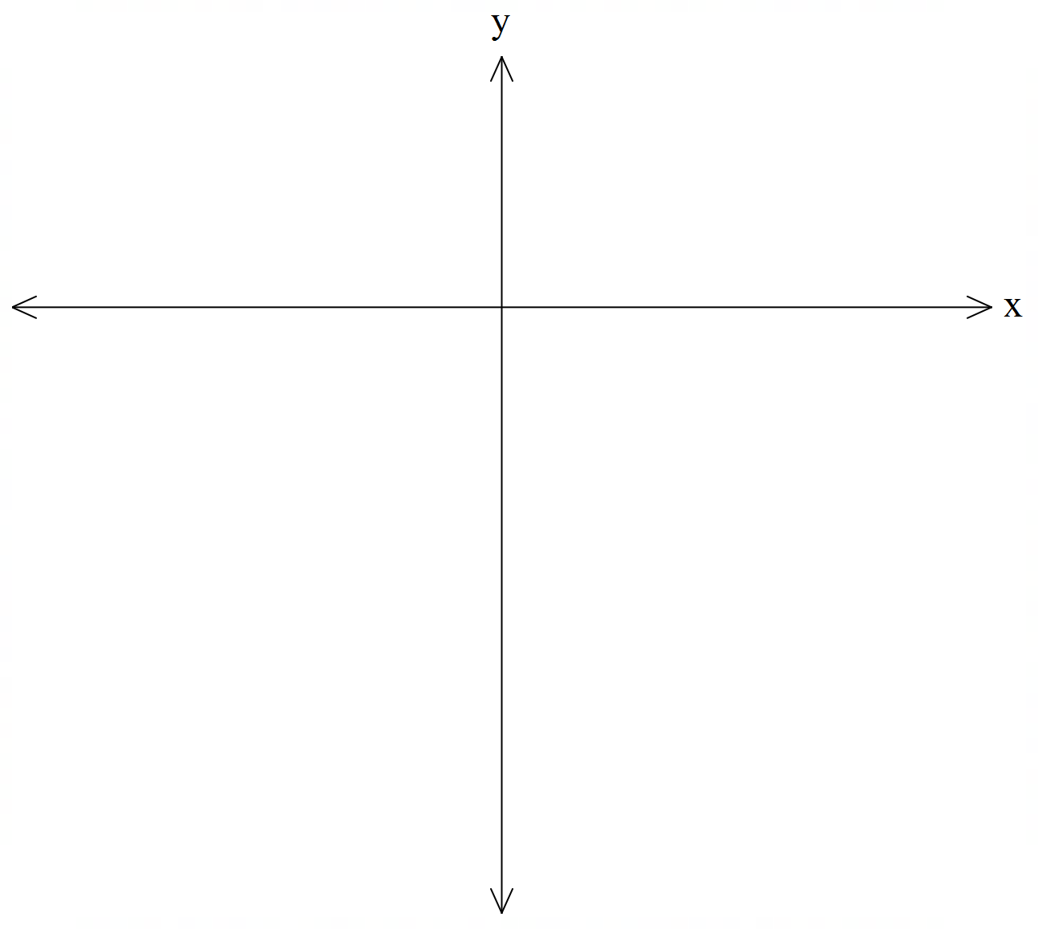


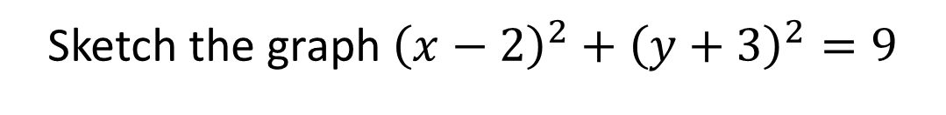
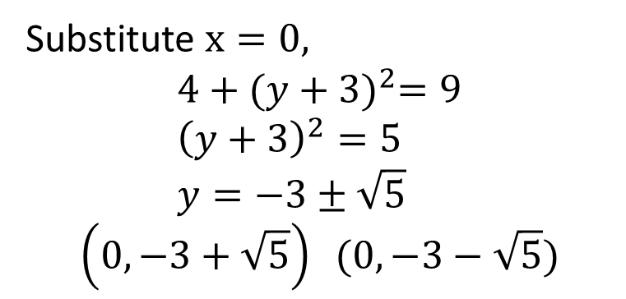
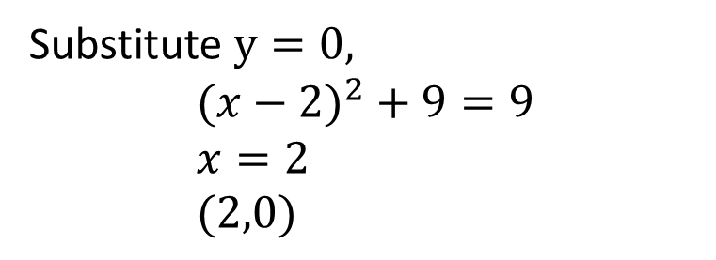



Guided Practice
Sketch the graph ${\left(x−2\right)}^{2}+{\left(y+3\right)}^{2}=9$
$$(2,−3)$$
Centre of the circle:
$$r=3$$
Radius:
$$(2,0)$$
x- intercepts:
Substitute $y=0,$ $$({x−2)}^{2}+9=9 \\ x=2 \\ (2,0)$$
$$(0,−3+\sqrt{5})$$
y- intercepts:
Substitute $x=0,$ $$4+{(y+3)}^{2}=9 \\ {\left(y+3\right)}^{2}=5 \\ y=−3±\sqrt{5}$$
$$\left(0,−3+\sqrt{5}\right) (0,−3−\sqrt{5})$$
$$(0,−3−\sqrt{5})$$

Slide 8
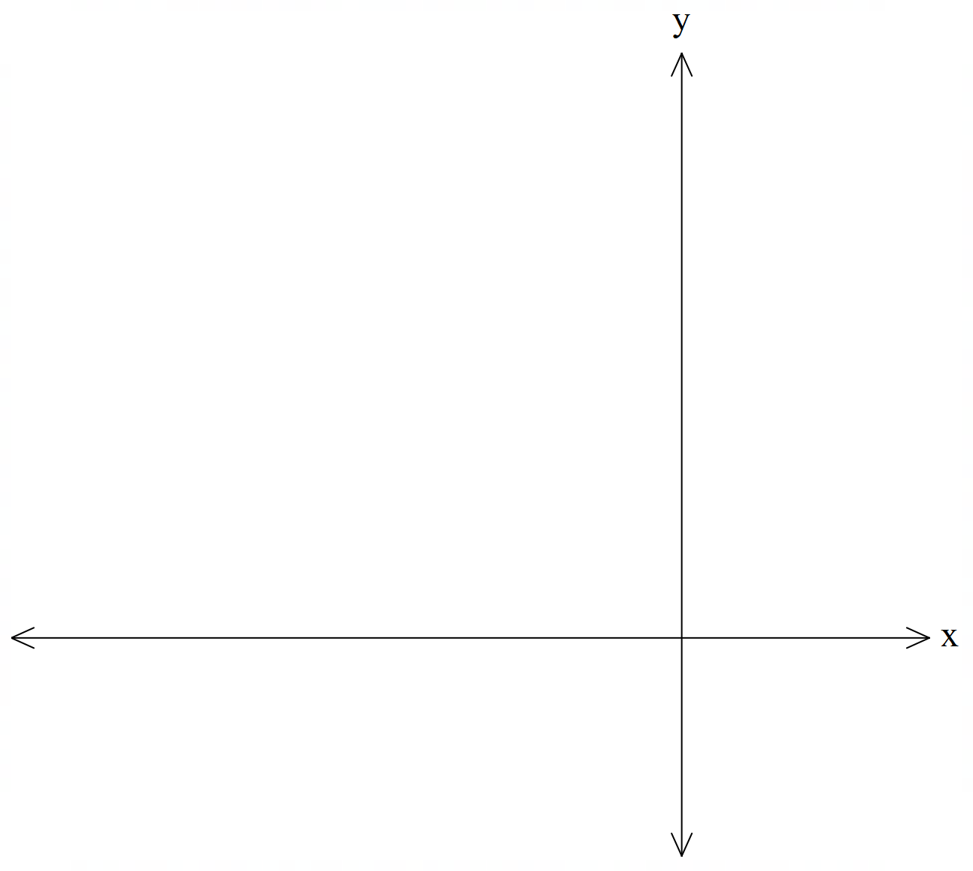

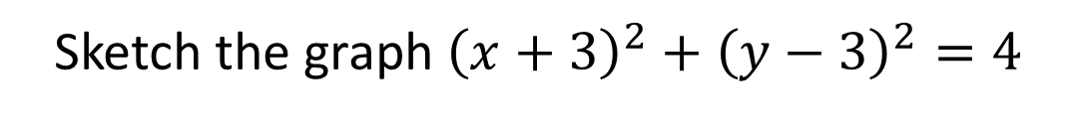
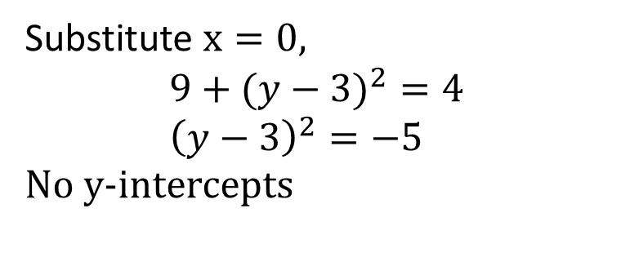
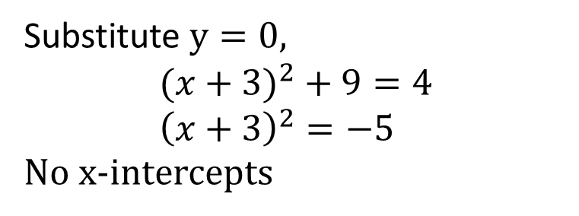



Guided Practice
Sketch the graph ${\left(x+3\right)}^{2}+{\left(y−3\right)}^{2}=4$
$$(−3,3)$$
Centre of the circle:
$$r=2$$
Radius:
$$(−3,5)$$
x- intercepts
Substitute $y=0,$ $$({x+3)}^{2}+9=4 \\ {\left(x+3\right)}^{2}=−5$$
No x-intercepts
y- intercepts:
Substitute $x=0,$ $$9+({y−3)}^{2}=4 \\ {\left(y−3\right)}^{2}=−5$$
No y-intercepts
$$(−3,1)$$

Slide 9

Concept Development
General form of a circle: $x^{2}+y^{2}+ax+by=c$
To find the centre and radius of the equation, we will need to rearrange the equation into the form
$${\left(x−h\right)}^{2}+{\left(y−k\right)}^{2}=r^{2}$$

Slide 10

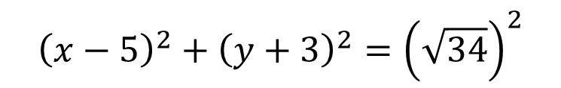



Guided Practice
Determine the centre and radius of the circle with equation $x^{2}+y^{2}+6y=10x$
Rearrange your equation and group all similar variables together
$$x^{2}−10x+y^{2}+6y=0$$
Complete the square for x and y
$${\left(x−5\right)}^{2}−25+{\left(y+3\right)}^{2}−9=0$$
Rearrange equation such that constants are on the right hand side
$${\left(x−5\right)}^{2}+{\left(y+3\right)}^{2}=34$$
$${\left(x−5\right)}^{2}+{\left(y+3\right)}^{2}={\left(\sqrt{34}\right)}^{2}$$
Answer the question
Centre: $\left(5,−3\right)$
Radius: $\sqrt{34}$

Slide 11





Guided Practice
Find the centre and radius of the circle with equation $x^{2}+y^{2}−6x−4y−12=0$
Rearrange your equation and group all similar variables together
$$x^{2}−6x+y^{2}−4y=12$$
Complete the square for x and y
$${\left(x−3\right)}^{2}−9+{\left(y−2\right)}^{2}−4=12$$
Rearrange equation such that constants are on the right hand side
$${\left(x−3\right)}^{2}+{\left(y−2\right)}^{2}=25$$
$${\left(x−3\right)}^{2}+{\left(y−2\right)}^{2}=5^{2}$$
Answer the question
Centre: $\left(3,2\right)$
Radius: $5$

Slide 12
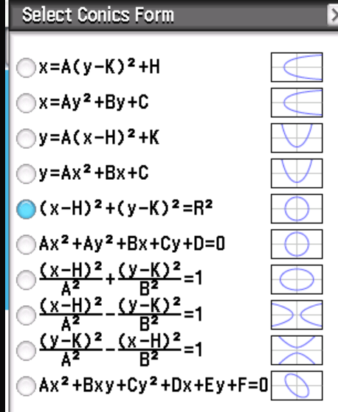
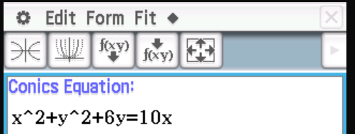

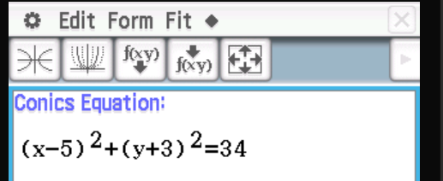
Changing form in ClassPad
Go to
Enter in Equation:$x^{2}+y^{2}+6y=10x$
Select

Slide 13




Semi-Circles
We can rearrange the equation of the circle to make $y$ the subject$x^{2}+y^{2}=r^{2}$
$$y^{2}=r^{2}−x^{2}$$
$$y=±\sqrt{r^{2}−x^{2}}$$
$y=+\sqrt{r^{2}−x^{2}}$ correspond to the top half of the circle
$y=−\sqrt{r^{2}−x^{2}}$ correspond to the bottom half of the circle
We can rearrange the equation of the circle to make $x$ the subject$x^{2}+y^{2}=r^{2}$
$$x^{2}=r^{2}−y^{2}$$
$$x=±\sqrt{r^{2}−y^{2}}$$
$x=+\sqrt{r^{2}−x^{y}}$ correspond to the right of the circle
$x=−\sqrt{r^{2}−y^{2}}$ correspond to the left of the circle

Slide 14
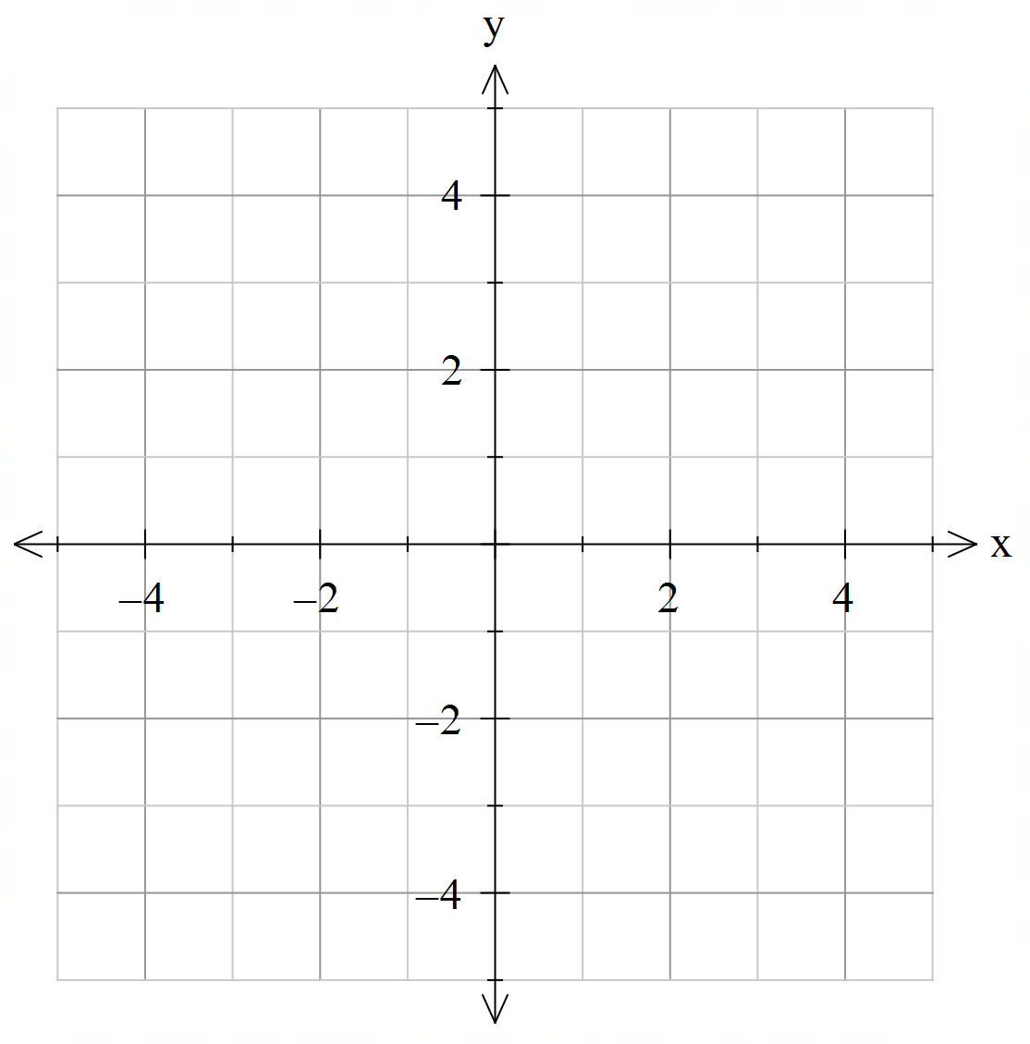
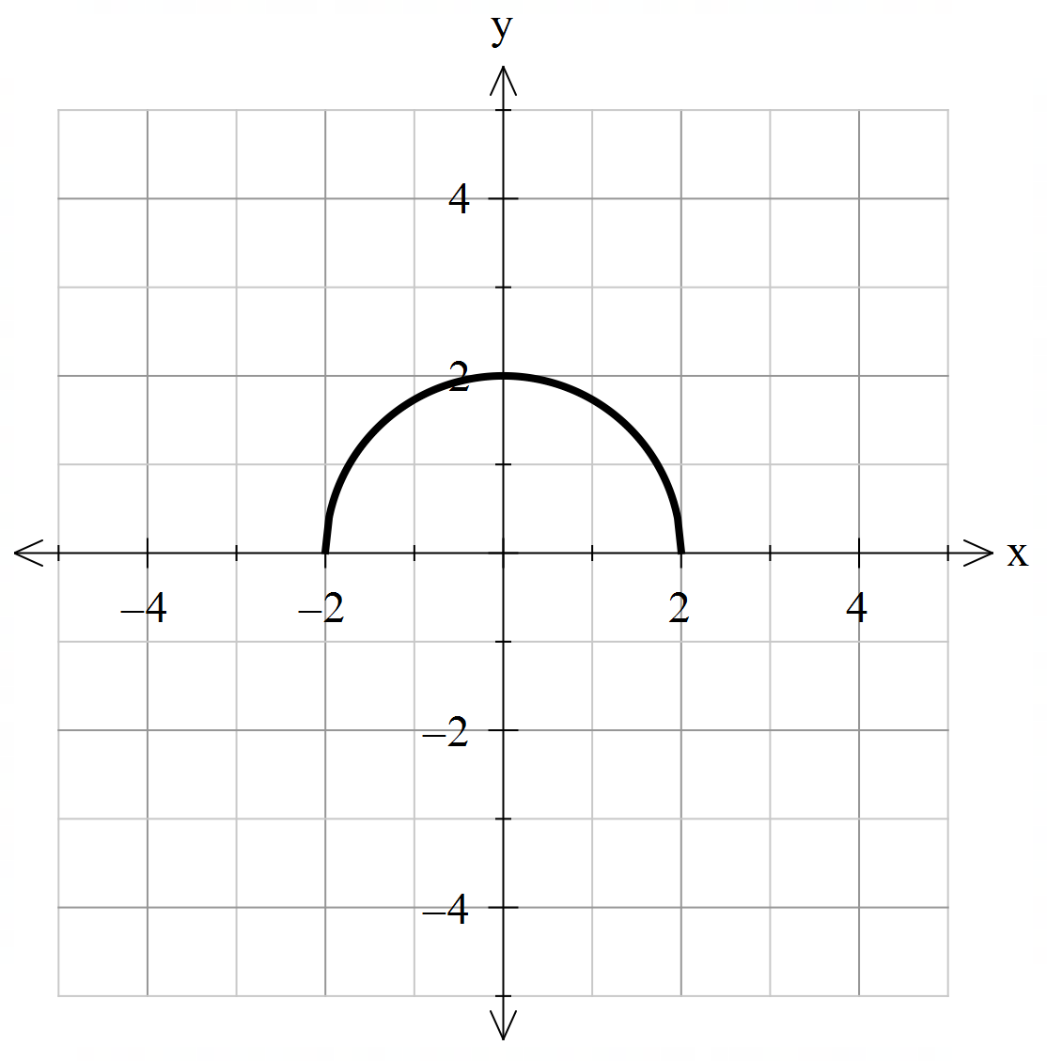
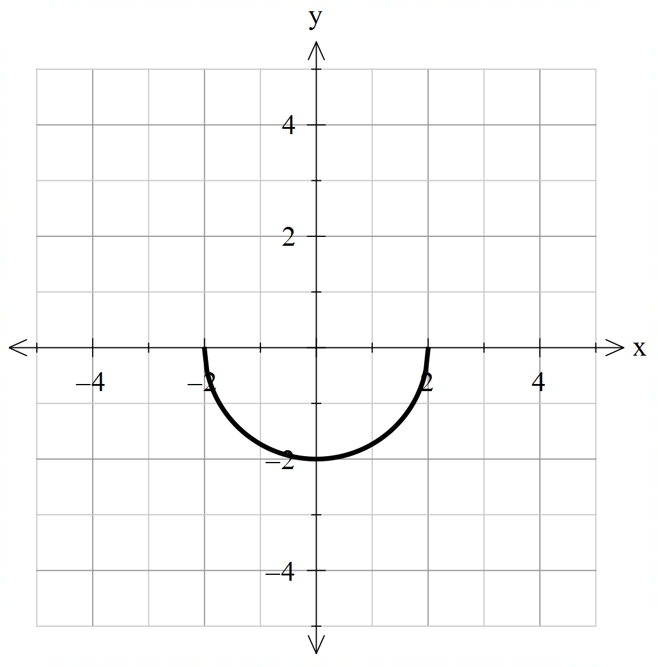
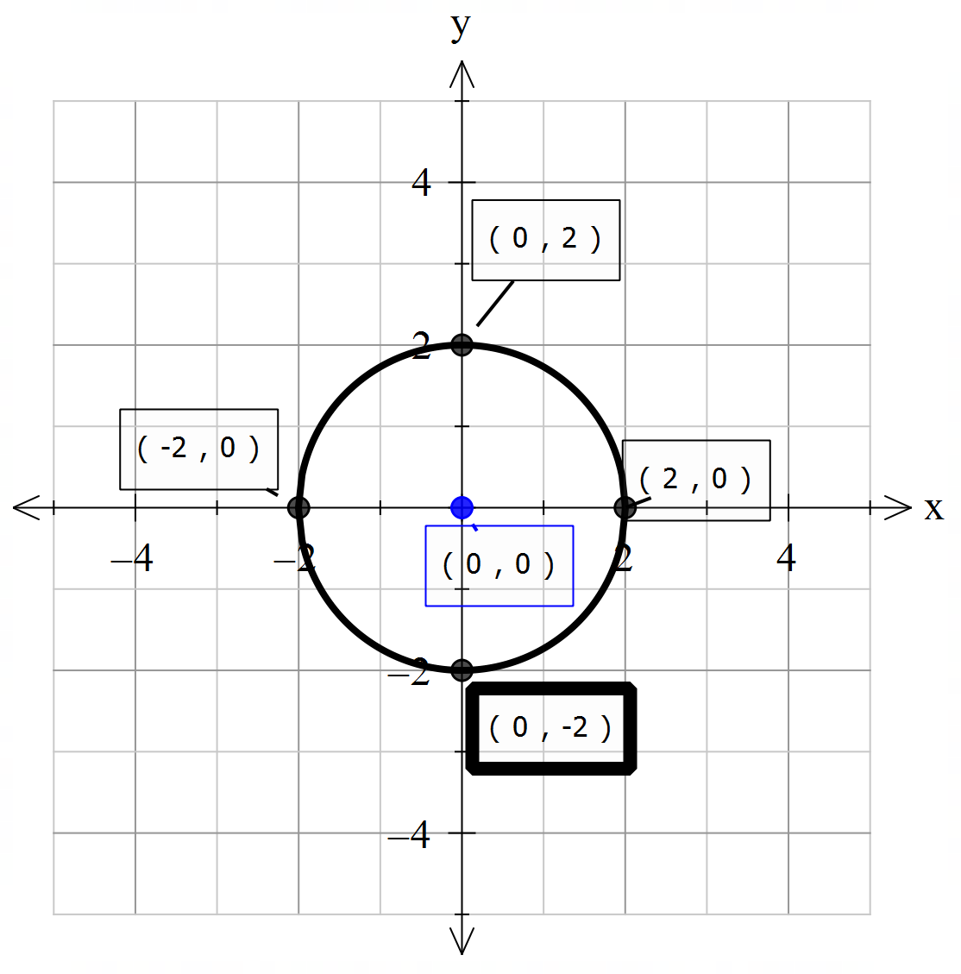
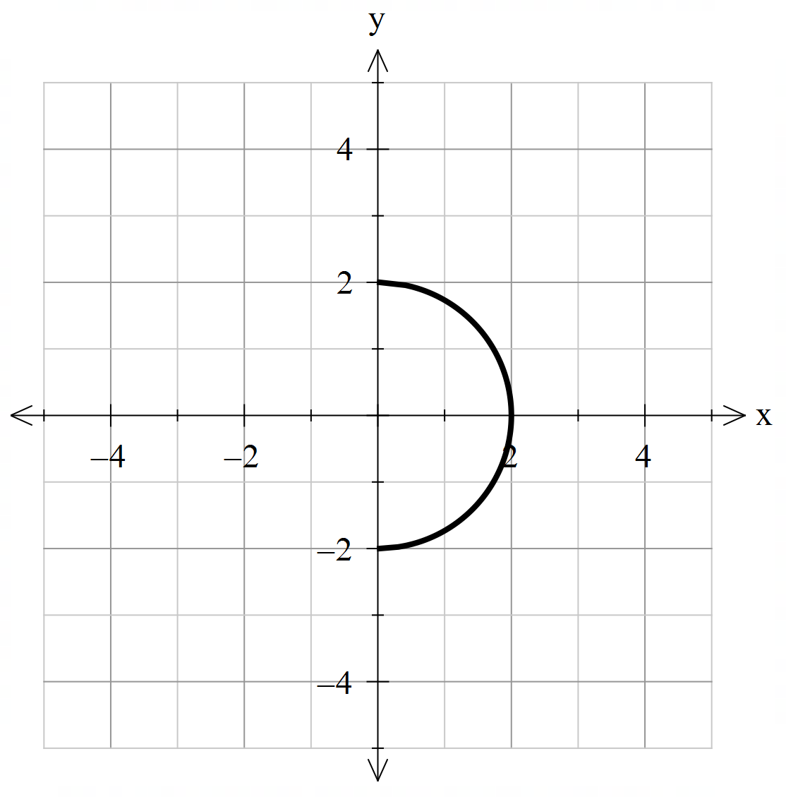
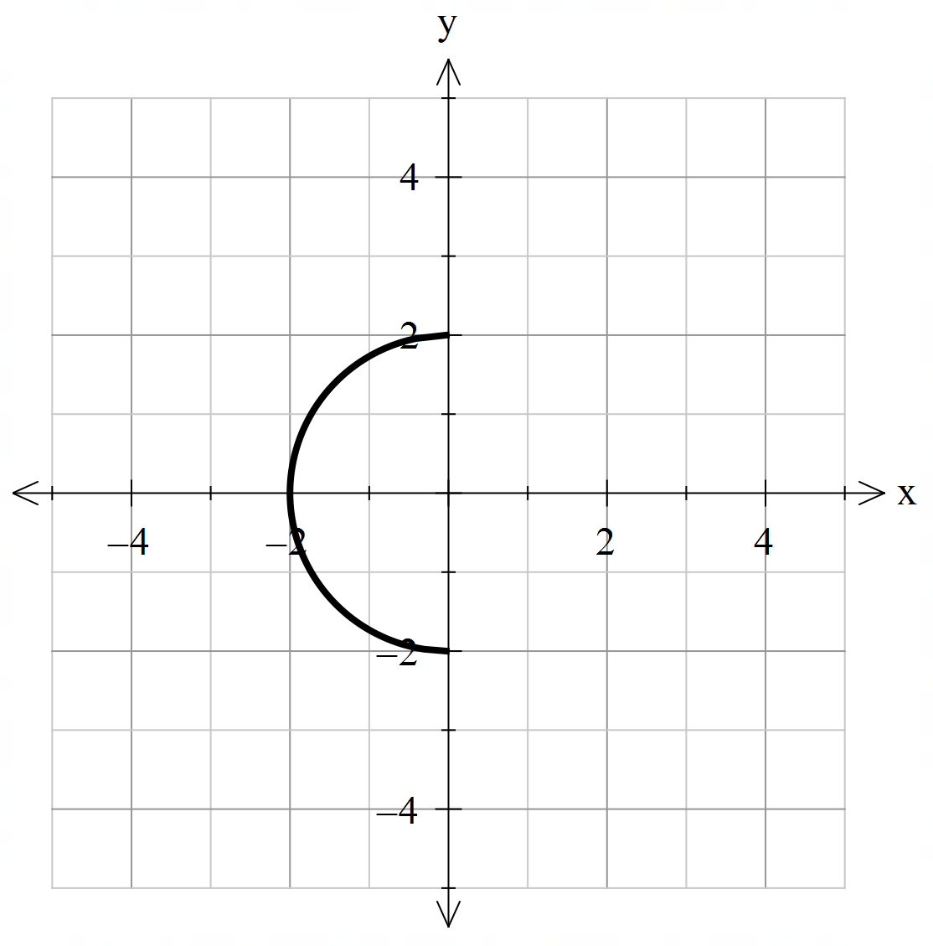

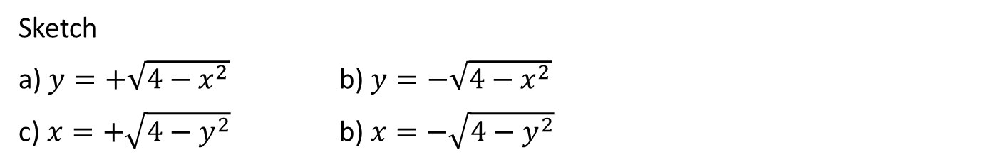

Guided Practice
Sketch
a) $y=+\sqrt{4−x^{2}}$ b) $y=−\sqrt{4−x^{2}}$
c) $x=+\sqrt{4−y^{2}}$ b) $x=−\sqrt{4−y^{2}}$
Sketching the graph $x^{2}+y^{2}=4$ first may help you
Centre: $\left(0,0\right)$
Radius: $2$

Slide 15
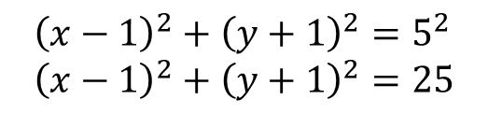



Cambrdige Ch 4E Ex 15
Find the equation of the circle whose centre is at the point $(1,−1)$ and passes through the point (4,3)
substitute: $h=1,k=−1$ into ${\left(x−h\right)}^{2}+{\left(y−k\right)}^{2}=r^{2}$
${\left(x−1\right)}^{2}+{\left(y+1\right)}^{2}=r^{2}$
substitute: $\left(4,3\right)$into ${\left(4−1\right)}^{2}+{\left(3+1\right)}^{2}=r^{2}$
$9+16=r^{2}$
$$r^{2}=25 \\ r=5$$
$${\left(x−1\right)}^{2}+{\left(y+1\right)}^{2}=5^{2} \\ {\left(x−1\right)}^{2}+{\left(y+1\right)}^{2}=25$$

Slide 16
Independent Practice
Cambridge Ex 4D Q1 – 6 only
Cambridge Ex 4E

